Slide 1
ITT565 Chapter 2 Server management and maintenance

Slide 2
Server management and maintenance
Server Management
Server Maintenance

Slide 3
Server Management
Server management is the process of monitoring and maintaining servers to operate at peak performance.
Server management also encompasses the management of hardware, software, security, and backups.

Slide 4
Server
A server is a piece of computer hardware or software (computer program) that provides functionality for other programs or devices, called "clients".
Typical servers are database servers, file servers, mail servers, print servers, web servers, game servers, and application servers.

Slide 5
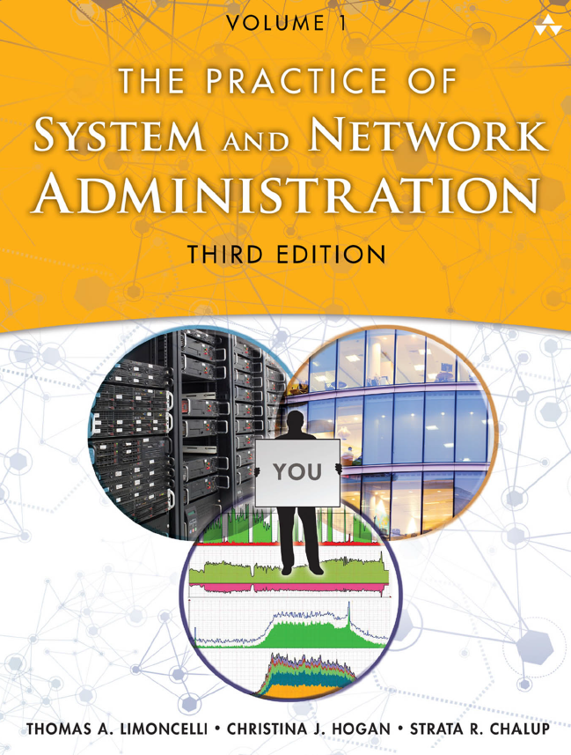
“web server” refer to a host being used to provide a web site (a machine) or the software that implements the HTTP protocol (Apache HTTPD).
the term “server” to mean a machine. It refers to a “service” as the entire hardware/software combination that provides the service users receive.
For example, an email server (the hardware) runs MS Exchange (the software) to provide the email service for the department.
Ref: page 221- chapter 13
Book: The Practice of System and Network Administration , Thomas A. Limoncelli

Slide 6
A single machine might provide one service or many.
For example, a single server might be a dedicated file server, or it might be a file server, a DNS server, and a wiki server while performing many other functions.
For example, Google’s Gmail service is distributed over thousands of machines, each doing a small fraction of the work.
By definition a server has dependents, usually many.
A single server may have hundreds of clients relying on it.
A web server may have thousands of users depending on it.
Contrast this to a laptop or desktop, which generally has just a single user

Slide 7
Server Management
There are many strategies for providing server resources.
Most organizations use a mix of these strategies.
The three most common strategies are:
All eggs in one basket: One machine used for many purposes.
Beautiful snowflakes: Many machines, each uniquely configured.
Buy in bulk, allocate fractions: Large machines partitioned into many smaller virtual machines (VM) using virtualization or containers.
-stranded capacity.
-benefit of isolation in virtualization.

Slide 8
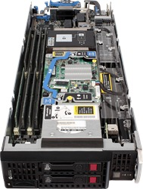
In addition, there are variations and alternatives :
• Grid computing: Many machines managed one as unit
• Blade servers:
A hardware architecture that places many machines in one chassis.
A blade server has many individual slots that take motherboard, that contain a computer or storage.
Each blade can be installed quickly and easily
• Cloud-based compute services: Renting use of someone else’s servers.
• Software as a service (SaaS): Web-hosted applications
• Server appliances: Purpose-built devices, each providing a different service.

Slide 9
Server Hardware Features
Server hardware generally falls into one of two major categories: enterprise and cluster.
Enterprise server hardware prioritizes the needs of commercial applications that enterprises tend to use: business applications, email servers, file servers, and so on.
These applications tend to assume data integrity and resiliency issues are handled at the hardware layer.
This is a polite way of saying they assume these responsibilities are someone else’s problem.
As a result, these models emphasize reliability, high availability, and performance.

Slide 10
Cluster server hardware prioritizes the needs of cluster or distributed computing applications such as Hadoop, Cassandra, web server farms, and so on.
These applications work around hardware failures through software-based resiliency techniques such as service replication with automatic failover.
They don’t require expensive hardware reliability options such as RAID cards.
These models are stripped down to the bare essentials: fast CPUs, network connections, and RAM.

Slide 11
Workstation versus servers Can I use a workstation as a server?
servers have higher uptime requirements than workstations, because many people rely on them.
Servers have higher data integrity requirements than workstations, because core enterprise data is stored and processed there.
Servers have higher CPU and memory requirements than workstations, because they are used for complex data processing, or to provide a service for many people.
Server operating systems are different from workstation operating systems. Also, we manage servers differently, from patching to configuration.

Slide 12
Server hardware design differences
More CPU performance
High-performance I/O
Expandability
Upgrade options
Rack mountable
Front and rear access
High availability options
Remote management

Slide 13
Server OS and management differences
Server hardware runs a server OS.
Microsoft Windows Server Edition includes additional software for providing services such as Active Directory.
It also is tuned for server operation instead of interactive performance: Various defaults are changed to provide better performance for long-running applications.
A Linux server is a server built on the Linux open-source operating system.
It offers businesses a low-cost option for delivering content, apps and services to their clients.

Slide 14
Server OS and management differences
A system is more reliable and secure when it is smaller.
Not having a GUI greatly reduces the memory footprint and not activating any video drivers avoids a major source of bugs and crashes.
Maintenance is easier because there are fewer software packages to be upgraded.

Slide 15
Server OS and management differences
Security is improved because a package that hasn’t been installed is one fewer source of vulnerabilities.
Often companies have a policy of installing security patches within a certain number of days after the vendor has released the patch.
For many servers, this means a constant flow of upgrades and reboots to patch software that isn’t even used.
By being disciplined and not installing unnecessary software, patch and reboot cycles will be reduced.

Slide 16
Server OS and management differences
Server OSs are often patched on a different schedule.
A patch is a set of changes to a computer program or its supporting data designed to update, fix, or improve it. This includes fixing security vulnerabilities and other bugs, with such patches usually being called bugfixes or bug fixes.
While workstations are updated frequently, often with user approval, servers are patched on a schedule that matches the requirements of the application.
That might mean weekly during off-hours, or monthly during carefully announced maintenance windows.

Slide 17
Server Maintenance
That might mean weekly during off-hours, or monthly during carefully announced maintenance windows.
The configuration of servers is also different.
Configuration management systems are used to configure and update the system.
Network configuration is generally done by hardcoding the configuration.

Slide 18
Server Maintenance
Server reliability
All devices fail. Thus, preparation towards failure is necessary.
Because servers need to be more reliable, and have higher uptime than workstations, one of the ways we prepare for equipment failure is to buy server hardware with additional features for reliability and data integrity.
When evaluating server hardware, it is important to understand these features, and to know which questions to pose to the vendors.
In addition, servers should be housed in a restricted-access, climate controlled environment, with protected power—in other words, a computer room or datacenter.

Slide 19
Server Reliability
Level of redundancy
Data Integrity
Hot-swap Component
Server location in computer room

Slide 20
Server Reliability - Level of redundancy
Servers often have internal redundancy such that one part can fail, and the system keeps running.
Example: There are two power supplies in the system.
Either can fail and the system keeps running.
Term as → N+1 redundancy → there is enough spare for one failures power supplies.
N+2 redundancy → there is enough spare for two failed power supplies.

Slide 21
Server Reliability - Data Integrity
Another aspect of server reliability is data integrity.
How do we know if the data stored on the machine will be available and valid in the future? Hard disks and SSDs eventually wear out and die.
In turn, we must have a plan to deal with this eventuality.
Not having a plan is as irrational as assuming our storage systems will last forever.
This is the options:
Raid (Redundant Array of Independent Disks)
Non-raid approach

Slide 22
Data Integrity
Raid (Redundant Array of Independent Disks) https://www.youtube.com/watch?v=U-OCdTeZLac
To make sure that the storage is always available ( irrational assumption)
Can make a reasonable simulation by using RAID level 1 and higher.
RAID 1→ store the data twice, once on each disk of a two-disk mirror. If one disk fails, the system can simply rely on the remaining disk.
RAID 2 and higher are similar, but create redundancy in a way that are more efficient, better performance and survive two disk failure.
RAID 0 → less resilient to failure.
Before RAID, if a disk died, the service died.
Non-raid approach
Assume data integrity is handle else where.
If the disk is fail, the server is shut down and repair.
After repair, it is recopied to from the master disk.

Slide 23
Server Reliability - Hot-swap Component
Server hardware has many redundant components, and these components should be hot-swappable.
Hot-swap refers to the ability to add, remove, and replace a component while the system is running.
Hot-swap components Increase cost.
The increase cost is justified when it eliminates downtimes for expansion or repairs.
When vendors makes a claim of hot- swappability, always asked two questions:
1) which part aren’t hot-swappable
2) in what way , and for how long, is service interrupted when the parts are being hot-swapped?
Some network devices have hot-swapped interface card, but the CPU is not hot-swappable.
Others claim hot-swap capability, but do not a full system reset after any device is added.

Slide 24
Server Reliability – Server Location
Servers should be installed in an environment with proper power, fire protection, networking, temperature and humidity control, and physical security.
That means a computer room or datacenter—not a spare cubicle or closet.
The two most important points are power and cooling.
For reliable operations, servers need power that is reliable and clean.
Servers are designed to run at a particular operating temperature, usually around 10 to 35◦C (50 to 95◦F). Cooling is required to remove the heat they generate

Slide 25
Remote server management
Servers need to be maintained remotely.
Remote management means that it should be possible to do all system administration tasks involving the machine from a remote location, except physical labor such as adding and removing physical hardware.
It should be possible to remotely access the machine’s console and, optionally, have remote control of the power switch.

Slide 26
Remotely managing servers
Integrated out-of-Band Management
Non-integrated out-of-band management
Separate Administrative Networks
OOB allows a system administrator to monitor and manage servers and other network-attached equipment by remote control regardless of whether the machine is powered on, or whether is installed or functional.
OOB is needed if an external company is managing some or all of the company’s network devices. It prevents the external company from accessing the data on the company’s network, while still allowing them to access the network devices.

Slide 27
Integrated out-of-Band Management
Modern servers have remote management capabilities built-in.
Such systems are generically called out-of-band (OOB) management, and have an Ethernet port as an interface.
Other terms you may hear (some of which are proprietary technologies) are lights-out management (LOM), Integrated Lights-Out (iLO), Intelligent Platform Management Interface (IPMI), remote insight board (RIB), or Remote Insight Light-Out Edition (RILOE).
Non-integrated out-of-band (OOB) management (page 255)
Remote power cycle
Remote console with IP-KVM
Remote console with serial Consoles
Separate Administrative Networks
Servers have separate NIC that is connected to a dedicated administrative network.
Benefit: isolate destructive traffic.

Slide 28
Maintenance Contract and spare parts
A maintenance contract is the written document that sets forth the terms of an agreement between a client and a maintenance service provider.
Vendor Service Level Agreement (SLA)
Spare Parts
Tracking Service Contracts
Cross-Shipping
Selecting Vendors with Server Experience

Slide 29
The End

